Slide 1
Task 1
Screenshot of solved Portswigger labs

Slide 2
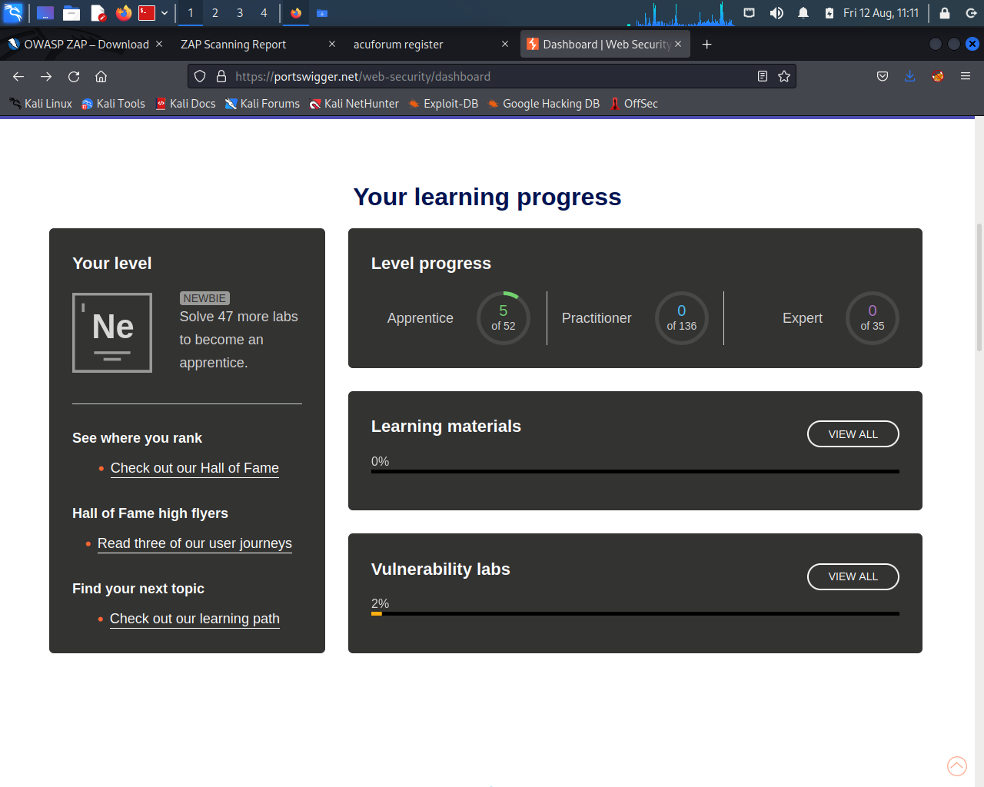
Screenshot 1

Slide 3
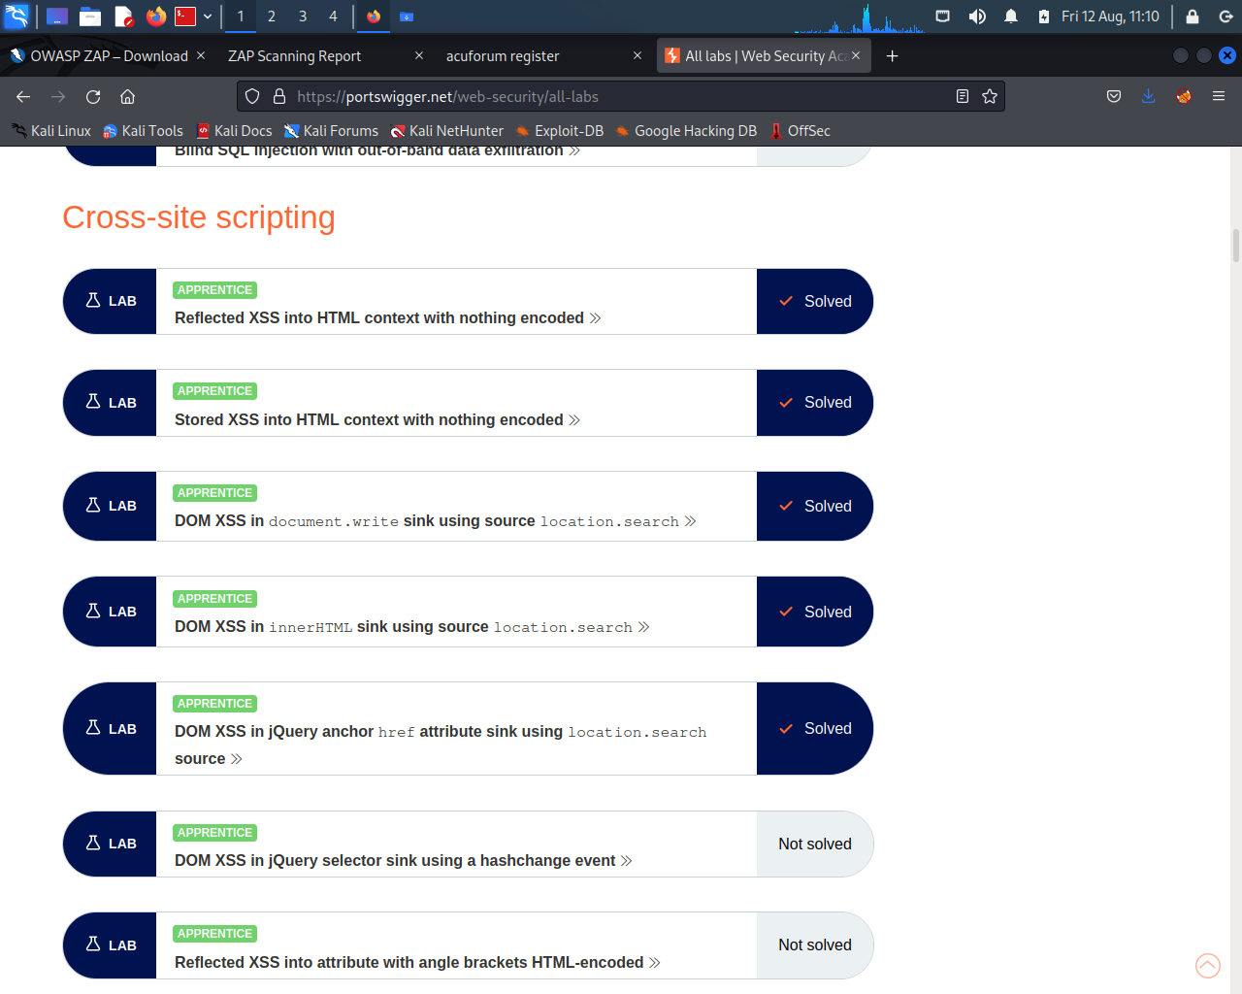
Screenshot 2

